Slide 1

Multithreaded Programming for Mere Mortals
Emery Berger, Charlie Curtsinger, Tongping Liu University of Massachusetts, Amherst

Slide 3
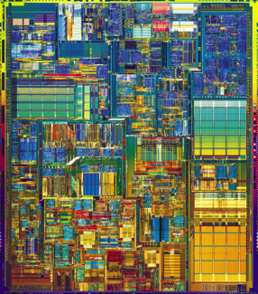
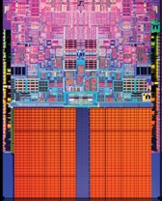

Slide 6


Slide 7
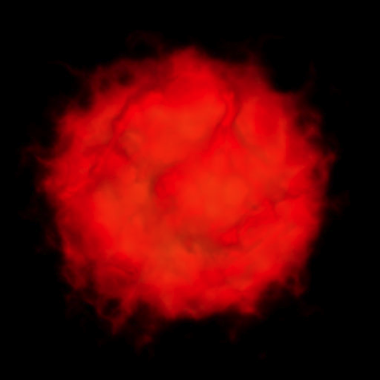

Slide 9
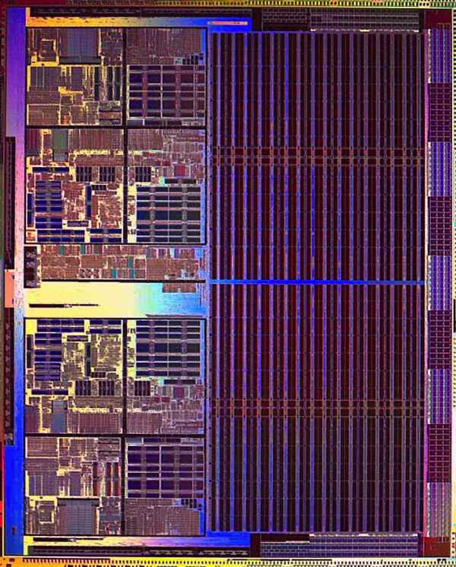

Slide 10
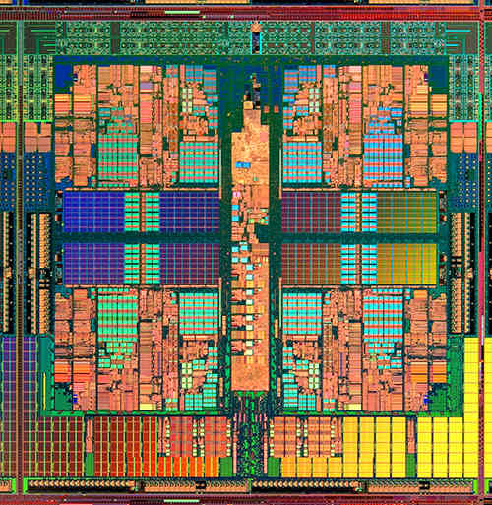

Slide 14
color = ; row = 0; // globals
void nextStripe(){
for (c = 0; c < Width; c++) {
drawBox (c,row,color);
}
color = (color == )?  : ; row++;
}
for (n = 0; n < 9; n++) {
spawn nextStripe();
}
sync;

Slide 15
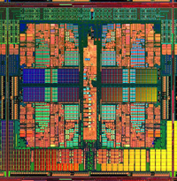
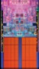
“
”

Slide 16
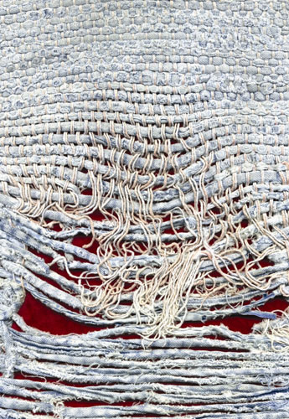
Notes:
Too few threads

Slide 17
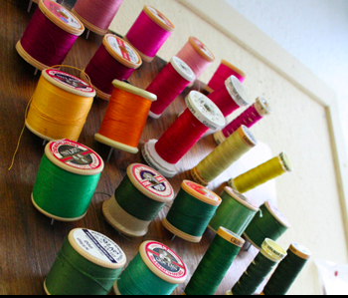
Notes:
Too many threads

Slide 18
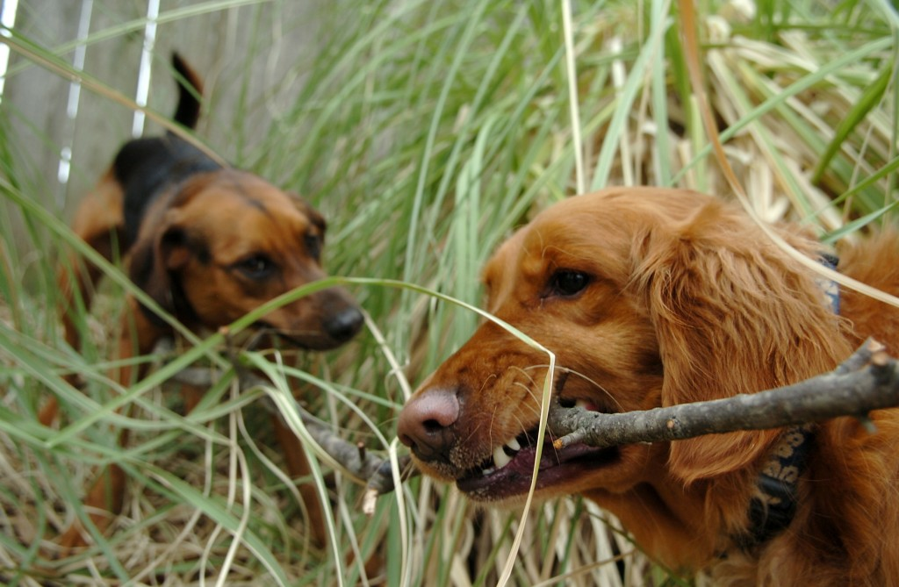

( )
Notes:
contention

Slide 19

Notes:
One big lock

Slide 20
Notes:
Fine-grained locks (lock acquisition overhead)

Slide 21

False Sharing!
Notes:
Insidious!

Slide 22
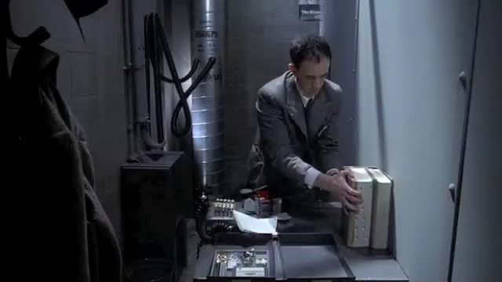
Notes:
(Brazil – didn’t know the desk was shared!)

Slide 23
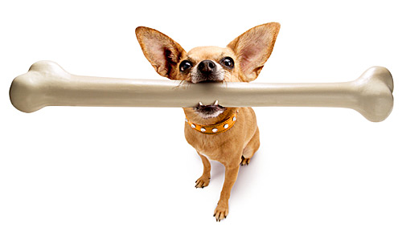
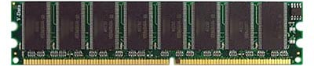
mine!
yours!
cache line
cache line
cache line
cache line
cache line

Slide 24
me = 1;
you = 1; // globals
me = new Foo;
you = new Bar; // heap
class X {
int me;
int you;
}; // fields
arr[me] = 12;
arr[you] = 13; // array indices

Slide 25
me = 1;
you = 1; // globals
me = new Foo;
you = new Bar; // heap
class X {
int me;
int you;
}; // fields
arr[me] = 12;
arr[you] = 13; // array indices

Slide 26
me = 1;
you = 1; // globals
me = new Foo;
you = new Bar; // heap
class X {
int me;
int you;
}; // fields
arr[me] = 12;
arr[you] = 13; // array indices

Slide 27
me = 1;
you = 1; // globals
me = new Foo;
you = new Bar; // heap
class X {
int me;
int you;
}; // fields
arr[me] = 12;
arr[you] = 13; // array indices

Slide 28
me = 1;
you = 1; // globals
me = new Foo;
you = new Bar; // heap
class X {
int me;
int you;
}; // fields
arr[me] = 12;
arr[you] = 13; // array indices

Slide 29

+ 850 lines…

Slide 30

No false positives
Sheriff-Detect
Object has 13767 interleaving writes
(starts at 0xd5c8e160, length 32).
Allocation call stack:
0: wordcount.c: 136
1: wordcount.c: 444
Precise object identification

Slide 31


Slide 32
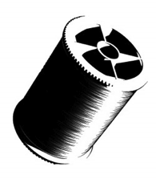
t1 = spawn f(x);
t2 = spawn g(y);
sync;

Slide 33

t1 = spawn f(x);
t2 = spawn g(y);
sync;
if (!fork())
f(x);
if (!fork())
g(y);

Slide 34
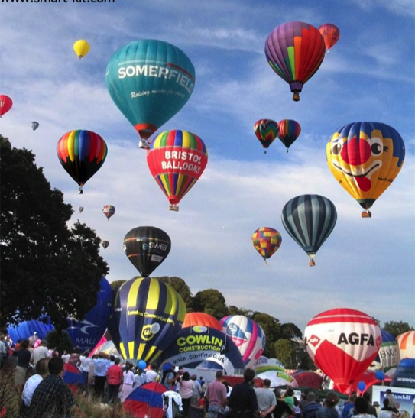
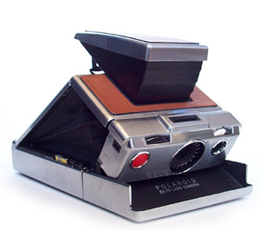

Slide 35
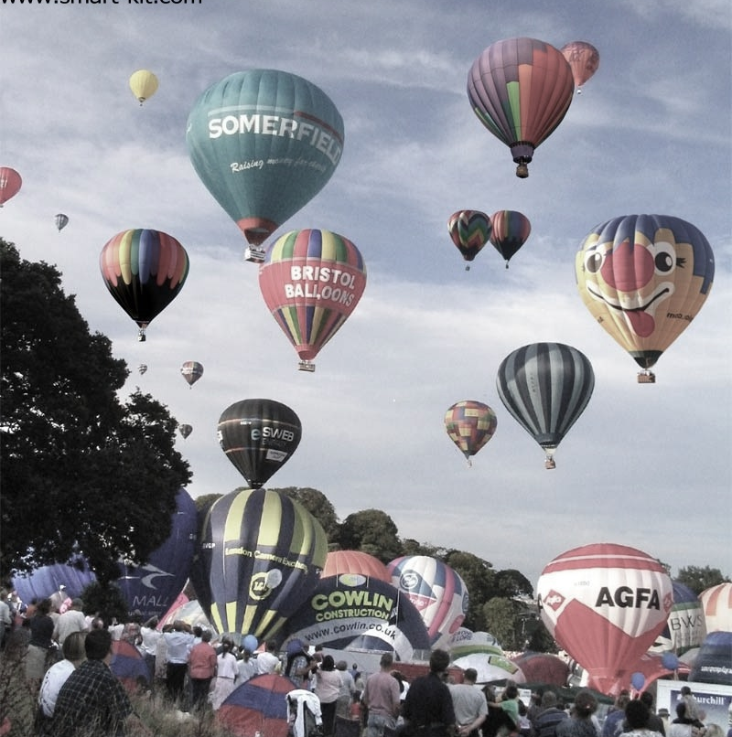
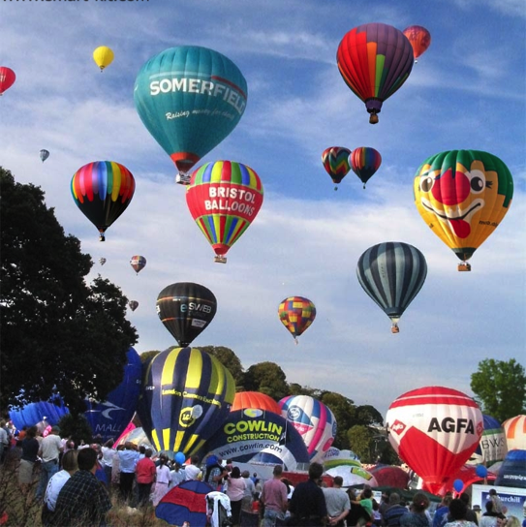

Slide 37
X
Y
for (i = 0; i < M; i++)
{
x = 1;
}
for (i = 0; i < M; i++)
{
y = 2;
}

Slide 38
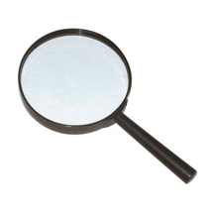
X
Y
0
0
0
0
for (i = 0; i < M; i++)
{
x = 1;
}
for (i = 0; i < M; i++)
{
y = 2;
}

Slide 39
X
Y
0
0
0
0
1
0
for (i = 0; i < M; i++)
{
x = 1;
}
for (i = 0; i < M; i++)
{
y = 2;
}

Slide 40
X
Y
0
0
0
0
1
0
0
2
for (i = 0; i < M; i++)
{
x = 1;
}
for (i = 0; i < M; i++)
{
y = 2;
}

Slide 41
X
Y
0
0
0
0
1
0
0
2

Slide 42
X
Y
0
0
0
0
1
0
0
2
1
0

Slide 43
X
Y
0
0
0
0
1
0
0
2
1
0

Slide 44
X
Y
0
0
0
0
1
0
0
2
1
2

Slide 45
X
Y
0
0
0
0
1
0
0
2
1
2

Slide 49
char padding[64];

Slide 50
Sheriff-Detect overhead
Sheriff-Detect

Slide 51


Slide 52

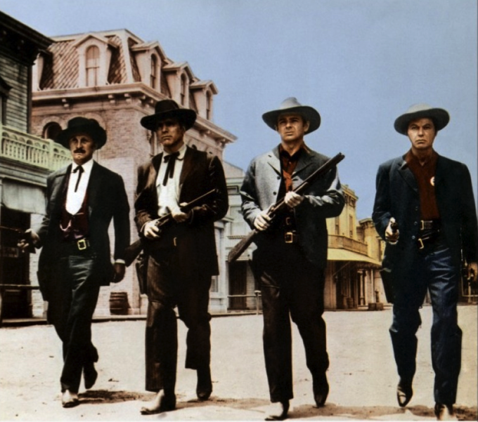
Prevents all false sharing
Sheriff-Protect

Slide 53

X
Y
0
0
0
0
1
0
0
2
for (i = 0; i < M; i++)
{
x = 1;
}
for (i = 0; i < M; i++)
{
y = 2;
}

Slide 54
Sheriff-Detect overhead
Sheriff-Detect
Sheriff-Patrol overhead
Sheriff-Protect

Slide 55

false sharing detection
original program
Sheriff-Detect
Sheriff-Detect

Slide 56

false sharing detection
Use Sheriff-Detect reports to guide modifications (padding, alignment)
original program
modified program
Sheriff-Detect
libpthread
False Sharing!
Sheriff-Detect

Slide 57
false sharing detection
Use Sheriff-Detect reports to guide modifications (padding, alignment)
original program
modified program
Sheriff-Detect
libpthread
False Sharing!
Sheriff-Detect
no false sharing
original program
libpthread

Slide 58

false sharing detection
Use Sheriff-Detect reports to guide modifications (padding, alignment)
original program
modified program
Sheriff-Detect
libpthread
False Sharing!
Sheriff-Detect
source code unavailable or insufficient resources to act on Sheriff-Detect reports
no false sharing
modifications degrade performance or cause excess memory consumption
original program
original program
libpthread
Sheriff-Protect
false sharing mitigation
Sheriff-Protect

Slide 59


Slide 60
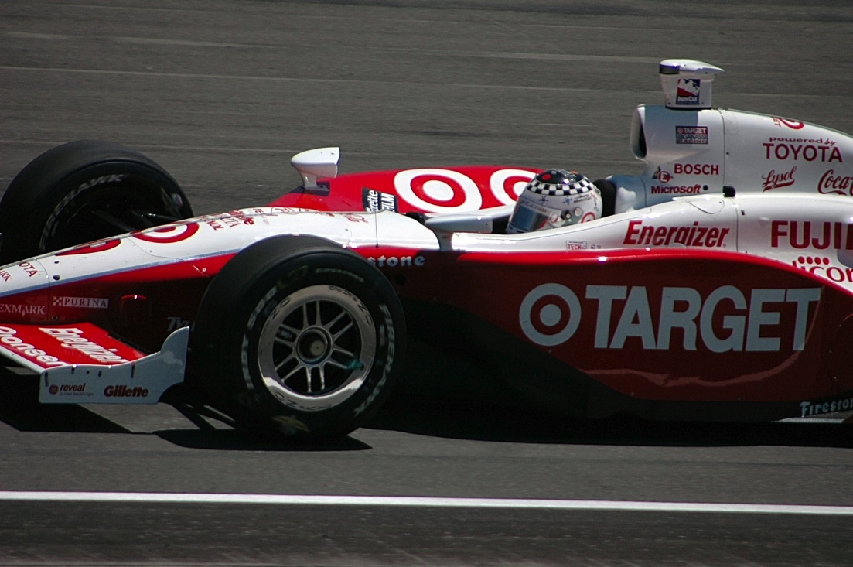

Slide 61
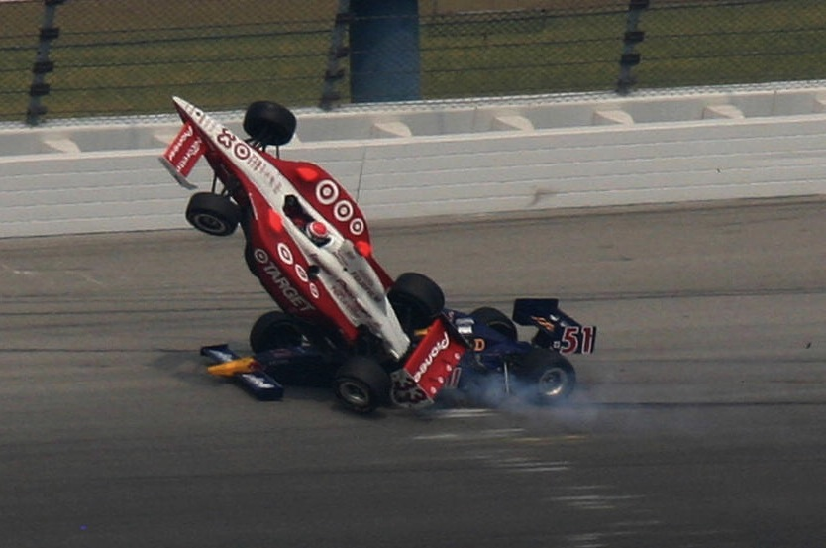

Slide 62
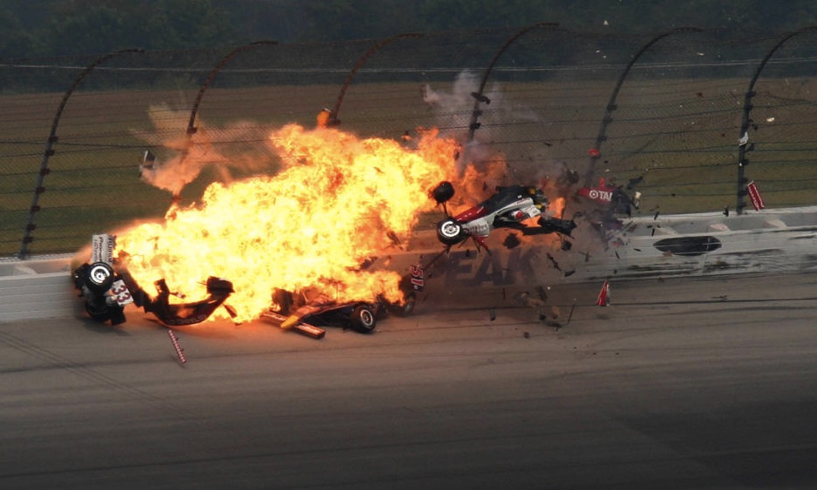

Slide 66
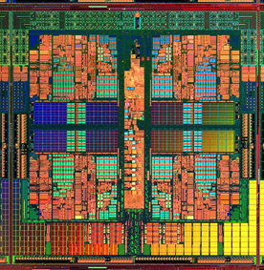
Dthreads
% g++ myprog.cpp –ldthreads –o myprog

Slide 67
race conditions
Dthreads
atomicity violations
deadlock
order violations

Slide 68

race conditions
Dthreads
atomicity violations
deadlock
order violations
deterministic

Slide 72


Slide 75
a b
a b
0 0
0 0

Slide 76
a b
a b
0 0
0 0
1 0
0 1

Slide 77
a b
a b
0 0
0 0
1 0
0 1
1 1

Slide 80
Sheriff-Detect
Sheriff-Protect

Slide 81
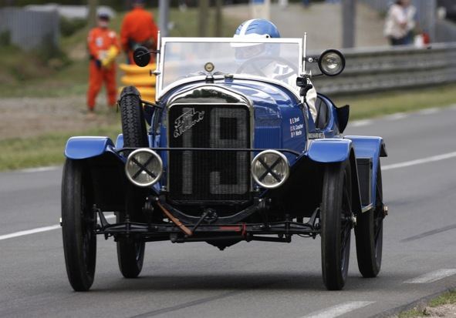
Sheriff-Detect
Sheriff-Patrol

Slide 82
Sheriff-Detect
Sheriff-Protect
Dthreads

Slide 83
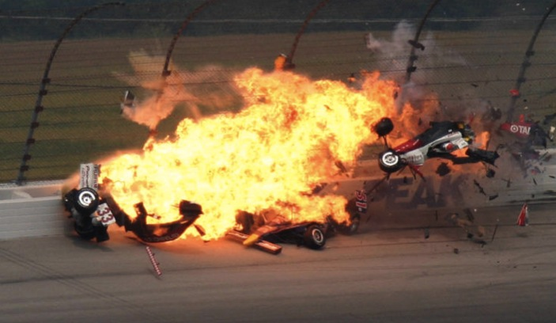
Sheriff-Detect
Sheriff-Protect
Dthreads
[OOPSLA 2011]
[SOSP 2011]

Slide 84
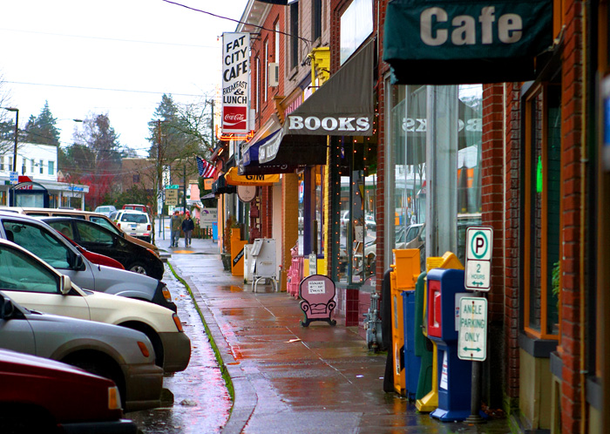
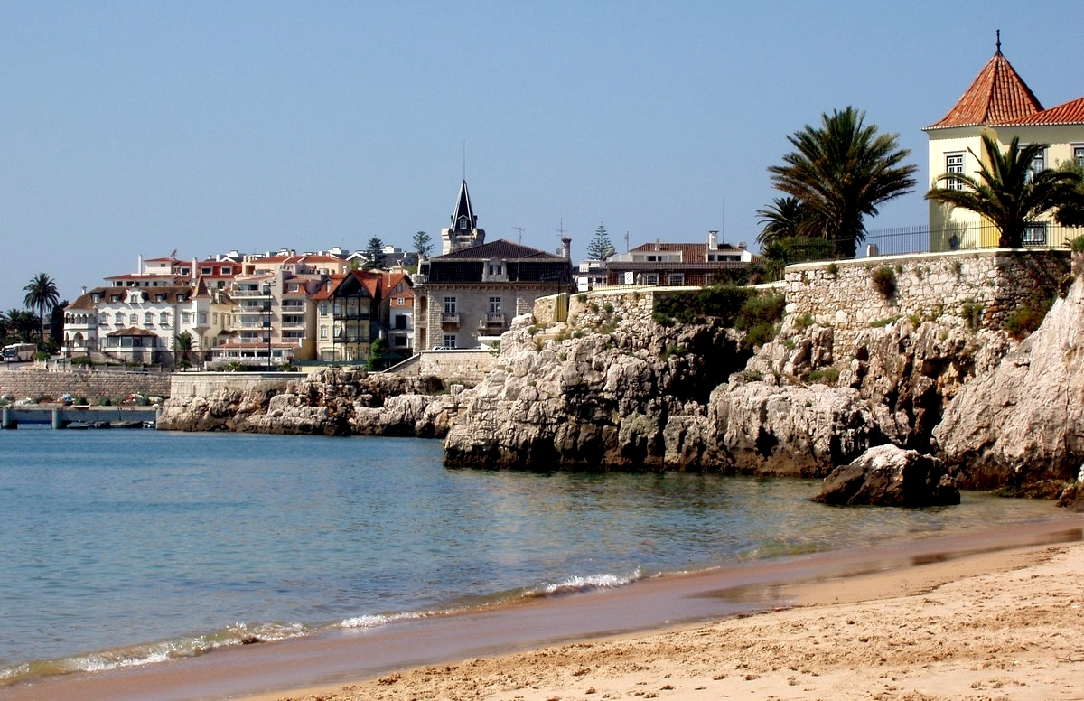
[OOPSLA 2011]
[SOSP 2011]

Slide 85
[OOPSLA 2011]
[SOSP 2011]

Slide 86
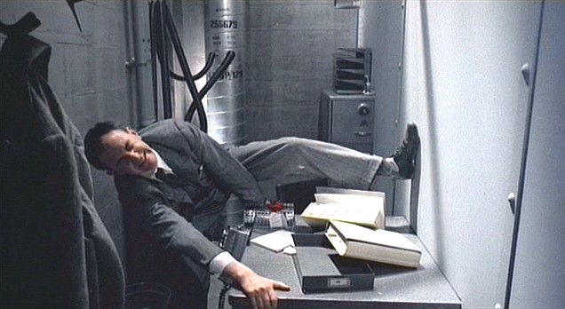
Notes:
(Brazil – didn’t know the desk was shared!)

Slide 87
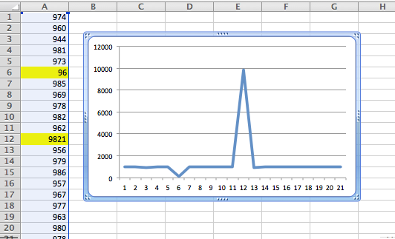
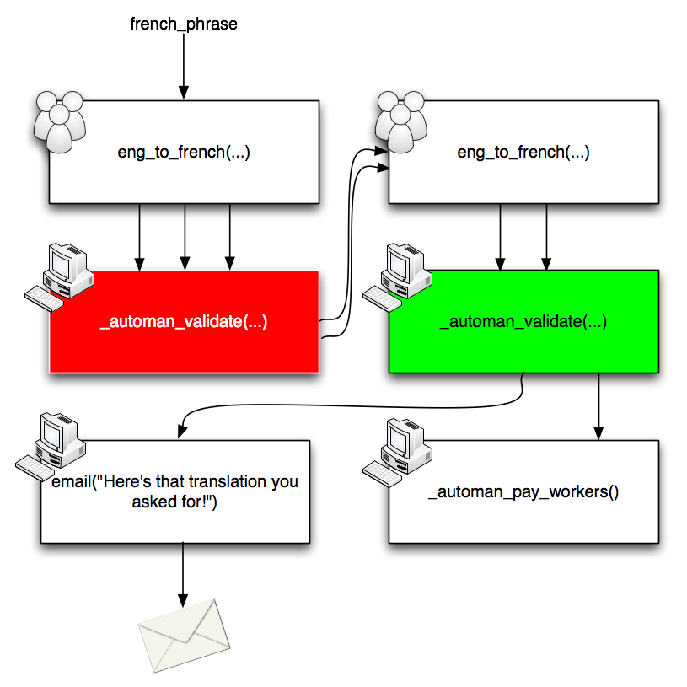



Stabilizer: Sound Performance Analysis
Data Debugging
AutoMan: Programming the Crowd
LockDown: Securing Software

